Slide 1
FIFA Player Analysis
Motivation & Methods
Motivation
Data Overview
Data Cleaning
Exploratory Data Analysis
Modeling
Model Selection & Feature Selection
Hypothesis Testing
Rumi A. Allbert
Results
Model Improvements and final results

Slide 2
Outline
Motivation & Methods
Motivation
Data Overview
Data Cleaning
Exploratory Data Analysis
Modeling
Model Selection & Feature Selection
Hypothesis Testing
Results
Model Improvements and final results

Slide 3
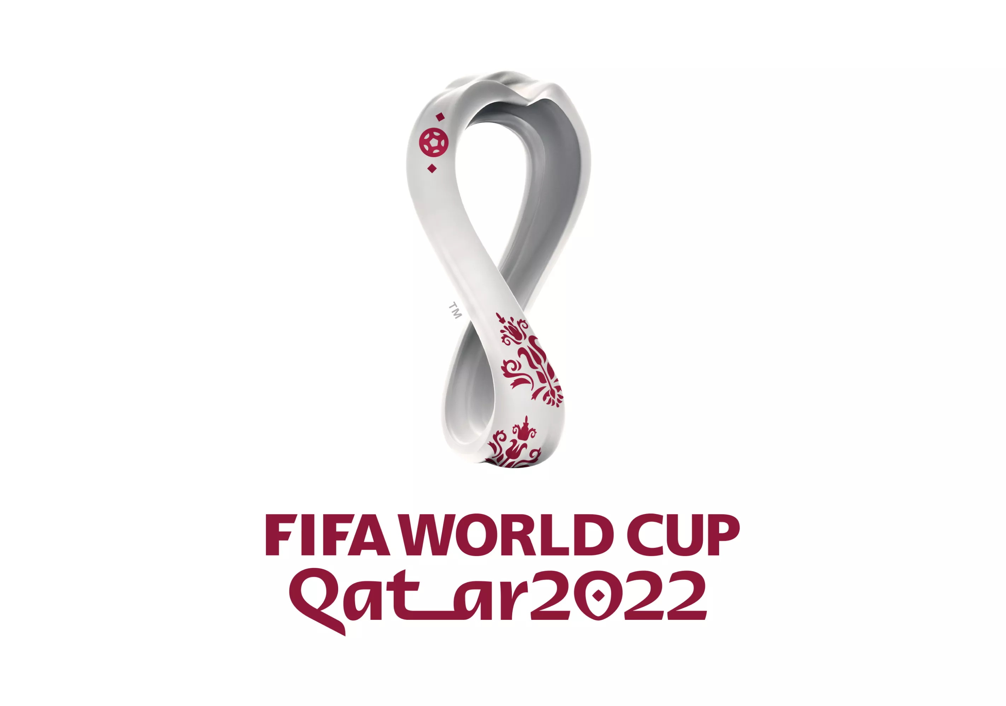
Motivation
WC currently taking place
Interested in what makes a ‘great’ and ‘valued’ soccer player.

Slide 4
Data Overview
Observations: 19,239
Including both female and male players.
Features: 110
Many are useless.
Sample of features:
Player position
Overall (score)
Potential (score)
Player value
Wage
Age
Height
Weight
Nationality

Slide 5
Soccer infographics
1
Mars
Despite being Red, Mars is a very cold place full of iron oxide dust
2
Venus
Venus has a beautiful name and is the second planet from the Sun
3
Saturn
Saturn is a huge gas giant, it’s the only planet with rings

Slide 6
Soccer infographics
6/6
2/6
5/6
3/6
Mars
Neptune
Saturn
The Earth
Mars is actually a cold place
Neptune is the farthest planet
Saturn is the ringed one
The Earth is the planet we live on

Slide 7
Soccer infographics
60%
40%
Mercury
Venus
It’s the closest planet to the Sun and the smallest one in the Solar System
Venus has a beautiful name and is the second planet from the Sun

Slide 8
Soccer infographics
Skill 1
Saturn is composed of hydrogen and helium
Skill 2
Despite being red, Mars is a cold place
Skill 3
Mercury is the closest object to the Sun

Slide 9
Soccer infographics
90:00
Team 1
Name
Team 2
Name
0:0
Despite being Red, Mars is a very cold place full of iron oxide dust
Neptune has a beautiful name and is the second planet from the Sun

Slide 10
Soccer infographics
It’s composed of hydrogen and helium
Has a very poisonous atmosphere
Mercury
Mars
It’s the smallest planet in the System
Despite being red, Mars is actually cold
Jupiter
Saturn
It’s the biggest planet in the Solar System
It’s composed of hydrogen and helium

Slide 11
Soccer infographics
Mercury | Mars | Jupiter | Saturn
It’s the smallest planet in the System | It’s a cold place. It’s full of iron oxide dust | It’s the biggest planet in the Solar System | It’s composed of hydrogen and helium

Slide 12
Soccer infographics
Earth
The Earth is the only planet that harbors life
Venus
Venus has a beautiful name, but it’s hot
Mercury
Mercury is the closest planet to the Sun

Slide 13
Soccer infographics
Venus
1
3
Pluto
Venus has high temperatures and a nice name
It’s so small that is now considered a dwarf planet
Mercury
2
4
Neptune
Mercury is the smallest planet of them all
Neptune is the farthest planet from the Sun

Slide 14
Soccer infographics
Mon | Tue | Wed | Thu | Fri | Sat | Sun
 |  | 01 | 02 | 03 | 04 | 05
06 | 07 | 08 | 09 | 10 | 11 | 12
13 | 14 | 15 | 16 | 17 | 18 | 19
20 | 21 | 22 | 23 | 24 | 25 | 26
28 | 29 | 30 | 31
Mercury
Is the closest planet to the Sun and the smallest one in the Solar System
Venus
Venus has a beautiful name and is the second planet from the Sun

Slide 15
Soccer infographics
Earth
The Earth is the only planet that harbors life
Venus
Venus has a beautiful name, but it’s hot

Slide 16
Soccer infographics
65 %
75 %
Jupiter
Saturn
Jupiter is the biggest planet of them all
Saturn is a planet with several rings
30 %
55 %
Venus
Earth
Venus has a really beautiful name
The Earth is the third planet from the Sun

Slide 17
Soccer infographics
0 | Information | 0
Team 1 | Statistics | Team 2
2 | Corners | 3
0 | Yellow cards | 2
1 | Red cards | 2

Slide 18
Soccer infographics
1
2
3
4
Venus
Mars
Earth
Jupiter
Venus has a beautiful name, but it’s a very hot place
Despite being red, Mars is actually a very cold place
Is the planet where we all live on the Solar System
It’s a gas giant and the biggest planet of them all

Slide 19
Soccer infographics
Mars
Venus
Despite being red, is actually a cold place
Venus is the second planet from the Sun
1
0
Saturn
Neptune
Saturn is composed of hydrogen and helium
Neptune is the farthest planet from the Sun

Slide 20
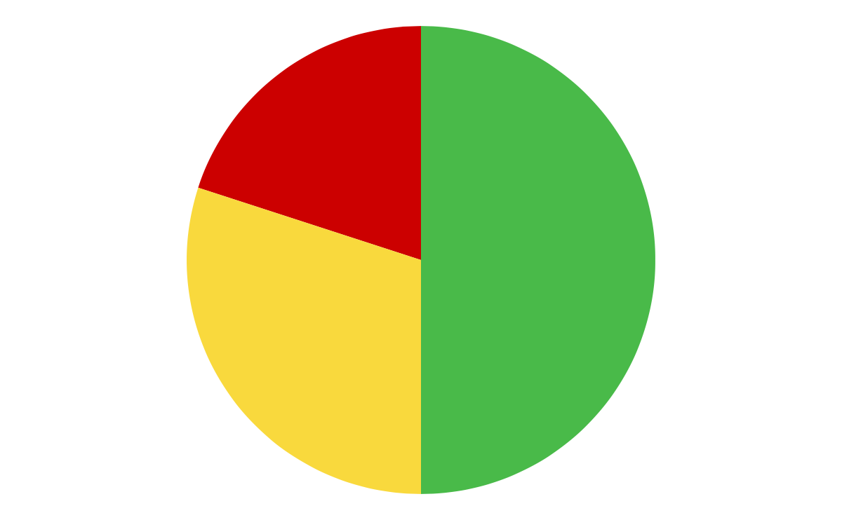
Soccer infographics
Mercury
20%
It’s the smallest planet of them all
Mars
50%
Despite being red, Mars is a cold place
30%
Jupiter
It’s the biggest planet in the Solar System
Follow the link in the graph to modify its data and then paste the new one here. For more info, click here

Slide 21
Soccer infographics
Mercury | Venus | Mars | Jupiter
01 | 02 | 03 | 04
Mercury is the smallest planet in the System | Venus has a toxic atmosphere and high temperatures | Mars is actually a very cold place full of iron oxide dust | Jupiter is a big gas giant and the biggest planet

Slide 22
Soccer infographics
Name of team
Name of team
Name of team
Name of team
Name of team
Name of team
Name of team
Name of team
Name of team
Name of team
Name of team
Name of team
Name of team

Slide 23
Soccer infographics
Mars
Saturn
Despite being Red, Mars is a very cold place full of iron oxide dust
Saturn is a gas giant and the only planet with rings in the Solar System
Neptune
Mercury
Neptune has a beautiful name and is the second planet from the Sun
Is the closest planet to the Sun and the smallest one in the Solar System

Slide 24
Soccer infographics
 | Saturn | Saturn is a gas giant and the biggest planet of them all
 | Pluto | Pluto is so small it’s considered a dwarf planet
 | Jupiter | It’s a gas giant and the biggest planet of all them
 | Mars | Has a beautiful name, but it’s a very hot place
25%
Mars
Despite being red, Mars is a very cold place
75%
Neptune
Neptune is the farthest planet from the Sun

Slide 25
Soccer infographics
Important notes
Jupiter is a gas giant and the biggest planet of them all
Material training | 1 | 2 | 3 | 4
Despite being red, Mars is actually a cold place
Venus is the second planet from the Sun
Saturn is composed of hydrogen and helium
Neptune is the farthest planet from the Sun

Slide 26
Soccer infographics
2nd
1st
3th
Mercury is the smallest planet
Mars is actually a very cold place
Venus has a beautiful name

Slide 27
Soccer infographics
Team 1
3/5
Despite being red, Mars is a very cold place
Team 2
5/5
The Earth is the only planet that harbors life
Team 3
2/5
Venus has a beautiful name, but it’s hot
Team 4
4/5
Mercury is the closest planet to the Sun

Slide 28
Soccer infographics
40%
Saturn
It’s the smallest planet in the Solar System
65%
Venus
It’s composed of hydrogen and helium
90%
Mercury
Venus has a very poisonous atmosphere
50%
Jupiter
It’s the biggest planet in the Solar System

Slide 29
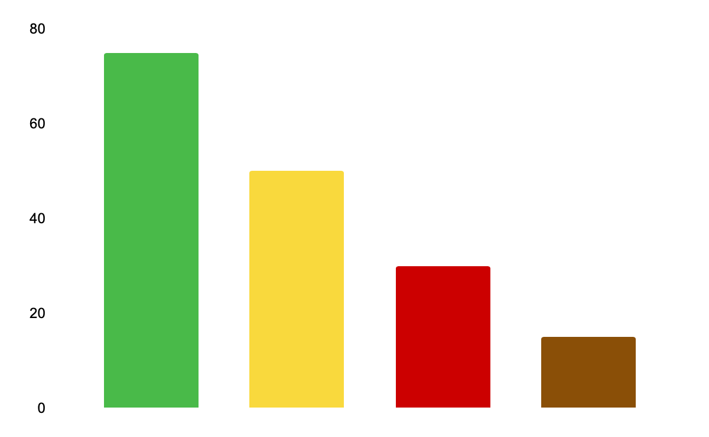
Soccer infographics
Mercury
It’s the smallest planet in the Solar System
Saturn
It’s composed of hydrogen and helium
Venus
Venus has a beautiful name, but it’s a very hot place
Mars
Despite being red, Mars is actually a very cold place
Follow the link in the graph to modify its data and then paste the new one here. For more info, click here

Slide 30
Soccer infographics
75%
50%
25%
Mercury
Venus
Jupiter
Mercury is the smallest planet in the Solar System
Venus has a beautiful name, but it’s a very hot place
It’s a gas giant and the biggest planet of them all

Slide 31
Soccer infographics
It’s the smallest planet in the Solar System
It’s composed mostly of hydrogen and helium
17%
30%
30%
23%
Venus has a very poisonous atmosphere
It’s a cold place. It’s full of iron oxide dust

Slide 32
Soccer infographics
Mercury
It’s the closest planet to the Sun and the smallest one in the Solar System—it’s only a bit larger than the Moon
45%
Venus
Venus has a beautiful name and is the second planet from the Sun. It’s hot and has a very poisonous atmosphere
55%

